Slide 1
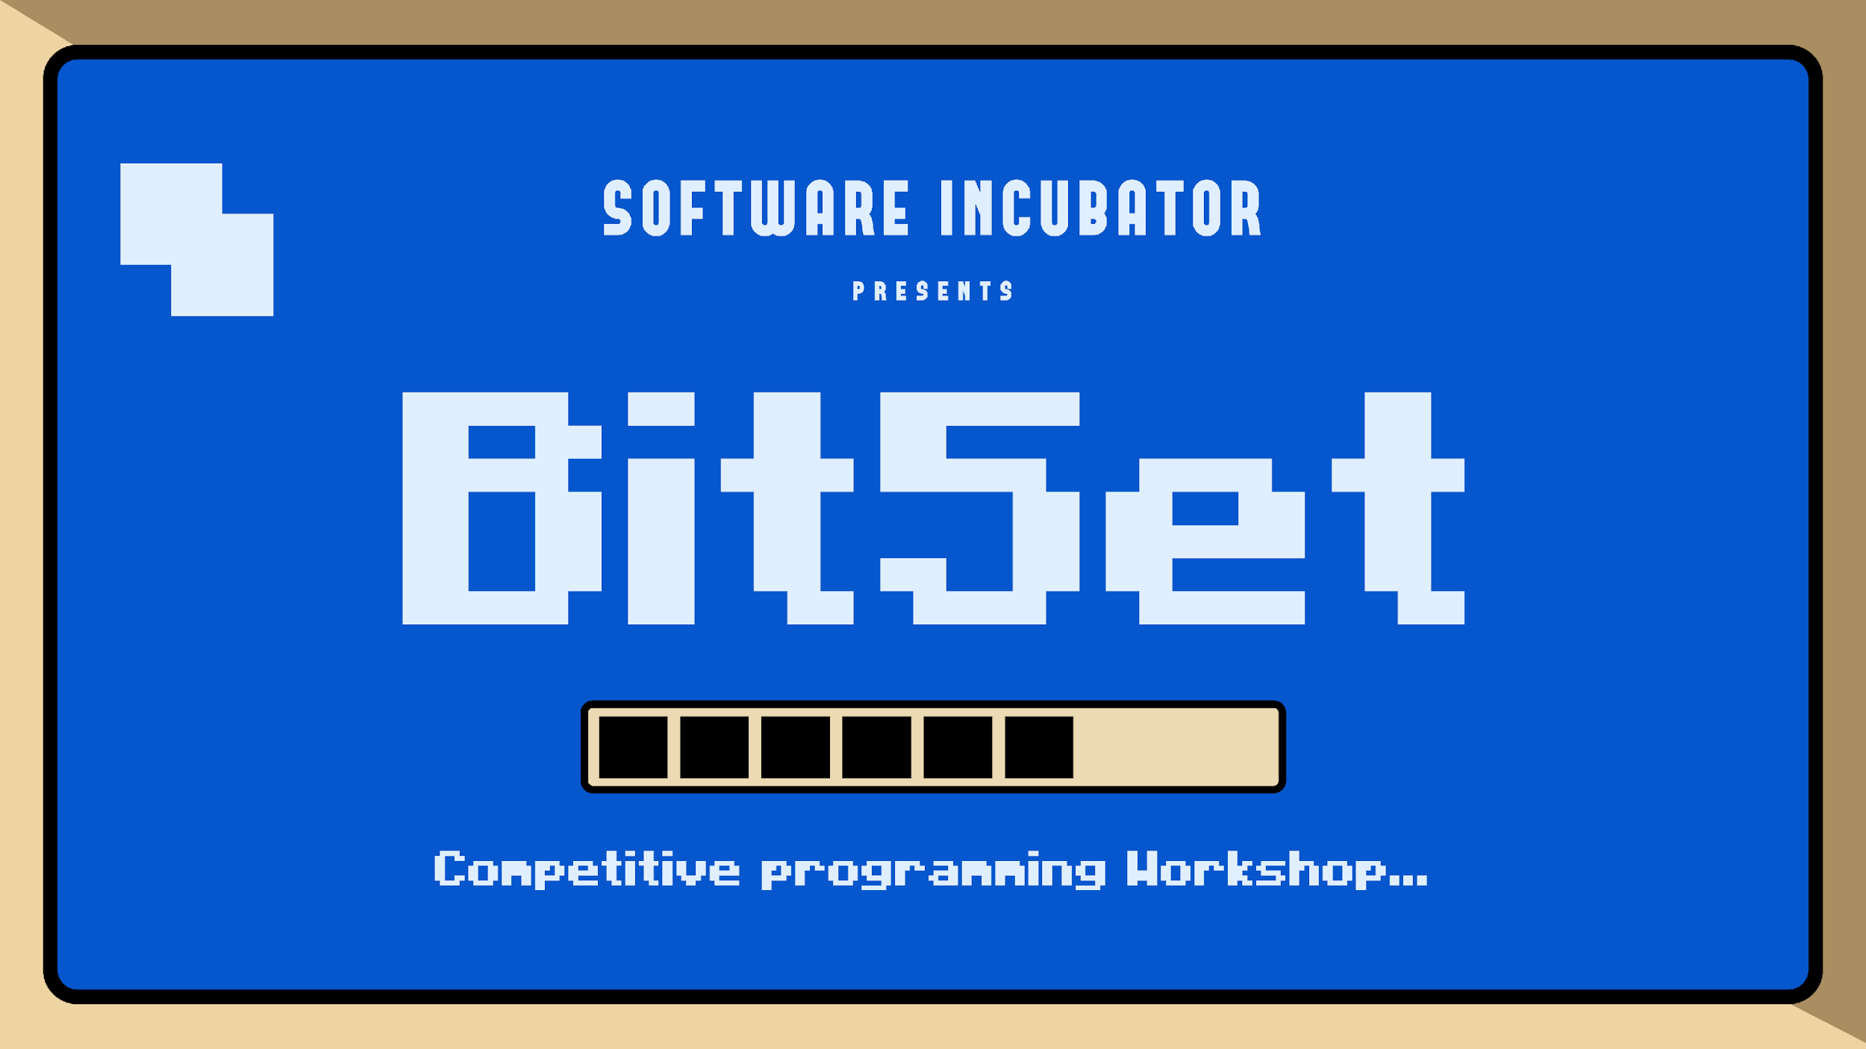

Slide 2




Slide 3

Why?

Slide 4
Let’s Begin

Slide 5
PRINT “HELLO WORLD” IN C++

Slide 6
#include<bits/stdc++.h>
using namespace std;
int main()
{
cout << "Hello World";
return 0;
}
Output
Hello World
01

Slide 7

Me After Printing ”Hello World” !!
02

Slide 8
DATA TYPES

Slide 9
Data Type is the type of data or information we are going to store in the variable.
E.g:- int, float, char, string, long long int etc.
E.g. int x = 10;
Datatype
Variable
https://www.geeksforgeeks.org/cpp-data-types/
03

Slide 10
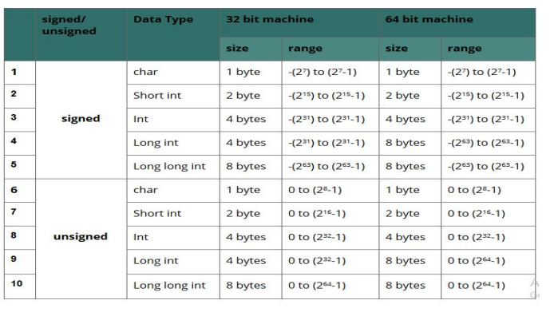
Range
04

Slide 11
INPUT/OUTPUT IN C++

Slide 12
#include<bits/stdc++.h>
using namespace std;
int main()
{
int x;
cin >> x;
cout << x;
return 0;
}
INPUT
5
OUTPUT
5
05

Slide 13
#include<bits/stdc++.h>
using namespace std;
int main()
{
int a, b;
float avg= 0;
cin>>a;
cin>>b;
avg = (a + b) / 2;
cout << avg;
return 0;
}
INPUT
4 5
OUTPUT
4
06

Slide 14
#include<bits/stdc++.h>
using namespace std;
int main() {
int a, b;
float avg= 0;
cin>>a;
cin>>b;
avg = (float)(a + b) / 2;
//avg=((float)a+b)/2;
//avg=(a+b)/2.0;
cout << avg;
return 0;
}
INPUT
4 5
OUTPUT
4.5
07

Slide 15
CONDITIONALS

Slide 16
if - else STATEMENT

Slide 17
if(marks>90)
{
// is true
MITHAI
}
else
{
// is false
KUTAYI
}
08

Slide 18
#include<bits/stdc++.h>
using namespace std;
int main() {
int a, b;
cin >> a >> b;
if(a > b) {
cout << a;
}
else {
cout << b;
}
return 0;
}
INPUT
3 7
OUTPUT
7
09

Slide 19
NESTED if - else

Slide 20
if(marks >= 90) {
// is true
MACBOOK
}
else {
if(marks > 40) {
PITAI
}
else{
GHAR SE NIKAL DIYA
}
}
10

Slide 21
#include<bits/stdc++.h>
using namespace std;
int main() {
int a, b;
cin >> a >> b;
if(a > b) {
cout <<a;
}
else {
if(b > a)
cout << b;
else
cout << "Numbers are equal";
}
return 0;
}
INPUT
7 7
OUTPUT
Numbers are equal
11

Slide 22
Else - If

Slide 23
if(marks > 90) {
// is true
MACBOOK
}
else if(marks > 40) {
// is true
PITAI
}
else {
// is false
GHAR SE NIKAL DIYA
}
12

Slide 24
#include<bits/stdc++.h>
using namespace std;
int main() {
int a,b;
cin >> a >> b;
if(a > b)
cout << a;
else if(a < b)
cout << b;
else
cout<<"Nos. are equal";
return 0;
}
INPUT
8 4
OUTPUT
8
INPUT
4 4
OUTPUT
Nos. are equal
13

Slide 25

https://bit.ly/Bit5et_SI
14

Slide 26
Temperature
You are given an integer T representing the current temperature in degrees Celsius. Based on the temperature, categorize the weather as Hot, Warm, Moderate, or Cold.
https://bit.ly/4immeaQ
15

Slide 27
SWITCH STATEMENTS

Slide 28
switch(expression) {
case x:
// code block
break;
case y:
// code block
break;
default:
// code block
}
16

Slide 29
int day = 3;
switch (day) {
case 1:
cout << "Monday";
break;
case 2:
cout << "Tuesday";
break;
case 3:
cout << "Wednesday";
break;
case 4:
cout << "Thursday";
break;
case 5:
cout << "Friday";
break;
case 6:
cout << "Saturday";
break;
case 7:
cout << "Sunday";
break;
}
17

Slide 30
ITERATION (LOOP)

Slide 31
#include<bits/stdc++.h>
using namespace std;
int main()
{
cout<<"Tareekh\n";
cout<<"Tareekh\n";
cout<<"Tareekh\n";
cout<<"Tareekh\n";
cout<<"Tareekh\n";
return 0;
}
Output
Tareekh
Tareekh
Tareekh
Tareekh
Tareekh
18

Slide 32
FOR LOOP
#include<bits/stdc++.h>
using namespace std;
int main()
{
for(int i=1; i<=5; i=i+1)
{
cout<<"Tareekh\n";
}
return 0;
}
Output
Initialization
Condition
Updation
Tareekh
Tareekh
Tareekh
Tareekh
Tareekh
19

Slide 33
WHILE LOOP
#include<bits/stdc++.h>
using namespace std;
int main()
{
int i = 1;
while(i <= 5) {
cout << "Tareekh\n";
i = i + 1;
}
return 0;
}
Output
Tareekh
Initialization
Condition
Tareekh
Tareekh
Tareekh
Updation
Tareekh
20

Slide 34
DO-WHILE LOOP
#include <bits/stdc++.h>
using namespace std;
int main()
{
int i = 1;
do {
cout << "Tareekh\n";
i = i + 1;
} while (i <= 5);
return 0;
}
Output
Tareekh
Tareekh
Tareekh
Tareekh
Tareekh
21

Slide 35
FLOW DIAGRAMS FOR ITERATION

Slide 36
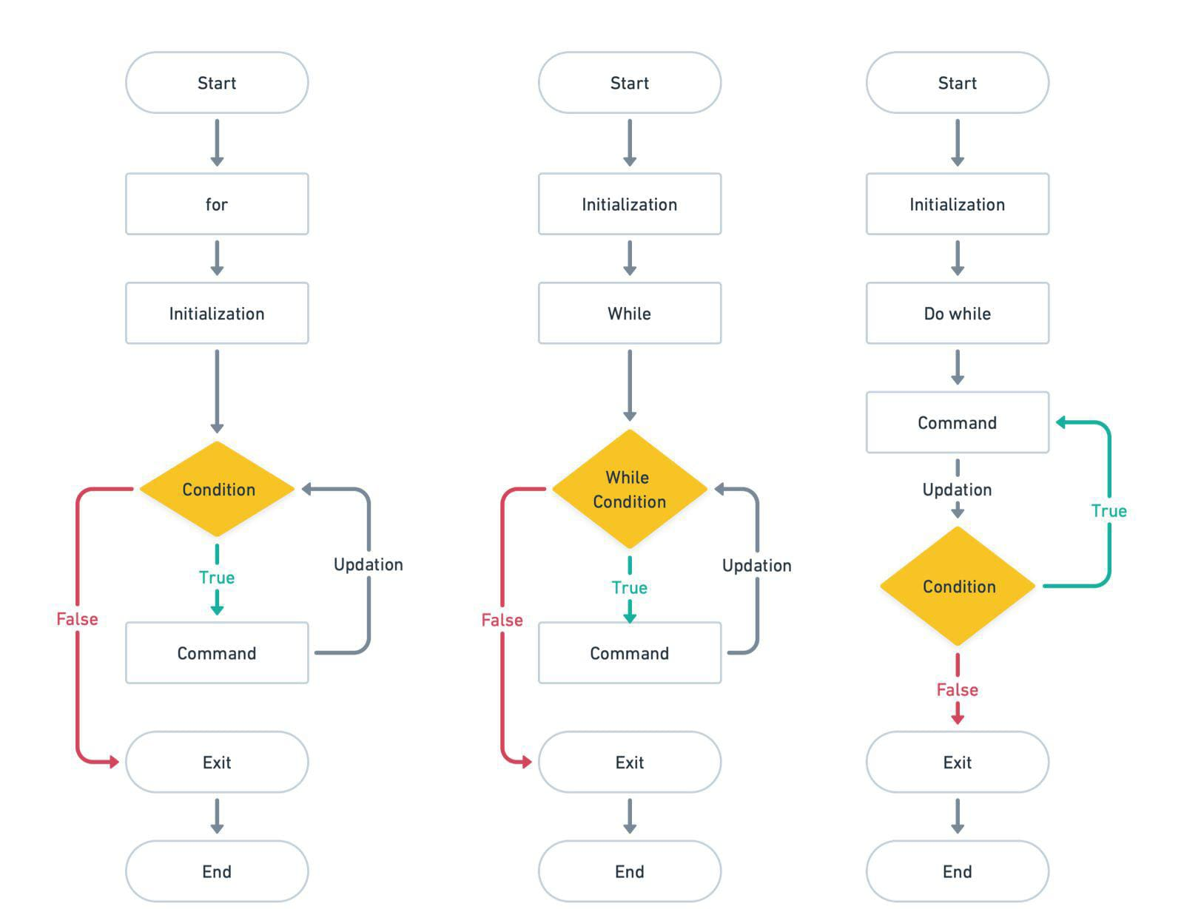
22

Slide 37
Break and Continue Statements
for(int i=1; i<=5; i++){
if(i==3) break;
cout<<i<<endl;
}
OUTPUT
1
2
OUTPUT
1
2
4
5
for(int i=1;i<=5;i++){
if(i==3) continue;
cout<<i<<endl;
}
23

Slide 38

ODD_SQUARES
Given an integer n . Find the sum of squares of first n odd positive numbers.The sum can go beyond the limit of an 32-bit integer so use 64-bit integer.
https://bit.ly/4i4R5bv
24

Slide 39
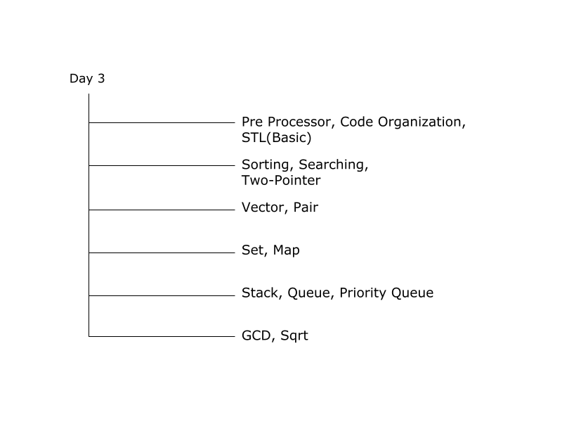
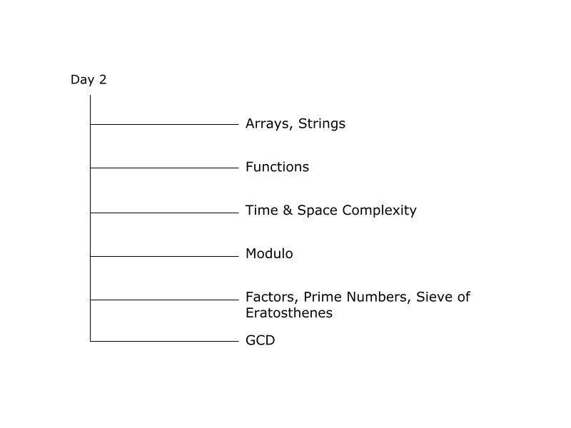
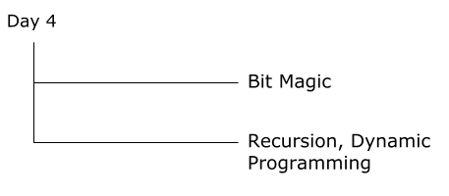
25

